Slide 1
Location of Culture
Inga-Britt Krause PhD

Slide 2
What we are going to do
Look at some basic terms – and what we mean by them
How do we want to position ourselves as clinicians?
Reflexivity –including that which is unconscious and outside awareness
Begin to think about how we choose what to be curious about in our work

Slide 3
Thomas Nagel
‘A view from nowhere is nothing but a view from ourselves’ ( The View from Nowhere, 1986).

Slide 4
What do we mean when we use the term ‘race’?

Slide 5
Race
Biology
Political – racism, a relationship of discrimination and inequality
3. As Ethnicity

Slide 6
Race
What is ‘race talk’ about?

Slide 7
What is ‘race talk’ about 1?
‘Race’ as term entered English language in 16th century referred to ‘family’, ‘lineage’, ‘breed’.
18th century, ‘race’ used about the natural world
The role of the entlightenment
Classification and evaluative judgements
The natural world, capitalism, colonisation, slavery

Slide 8
What is ‘race talk’ about 2?
1. A defensive organisation of the mind against anxiety
2. Universal human processes of projection
3. Universal human processes of splitting
4. Internal racist organisation of the mind: a defensive organisation of the mind in which all those who take part are allotted roles and must keep to those roles

Slide 9
Racialisation
The process of manufacturing and utilising the notion of race in any capacity
Racialising hatred or idealisation
Also in clinical work

Slide 10
ethnicity
What do we mean when we use this term?

Slide 11
Ethnicity
Group vs. category
About boundary
A process through which boundaries are constructed, maintained and changed
Identity and politics

Slide 12
culture
What do we mean by ‘culture’?

Slide 13
Culture
Culture is meaning. Implications are:
1. Not everyone share the same meaning and
persons do not know all the variations of meaning which make up an idea which they hold.
2. Persons participate in patterns of which they do not know the meaning.

Slide 14
Instituionalized Racism
The collective failure of an organisation to provide an appropriate and professional service to people because of their colour, culture and ethnic origin. It can be seen or detected in processes, attitudes and behaviour, which amount to discrimination through unwitting prejudice, ignorance, thoughtlessness and racist stereotyping which disadvantage minority ethnic people.
(The Stephen Lawrence Enquiry p.28)

Slide 15
Winnicott on Culture
‘I have used the term ‘cultural experience’ as an extension of the idea of transitional phenomena and play without being certain that I can define the word ‘culture’. The accent is indeed on experience. In using the word ‘culture’ I am thinking of inherited tradition. I am thinking of something that is in the common pool of humanity, into which individuals and groups of people may contribute, and from which we may all draw if we have somewhere to put what we find’

Slide 16
Winnicott
It can be seen ‘how important it can be for the analyst to recognize the existence of this place, the only place where play can start, a place that is the continuity-contiguity moment, where transitional phenomena originate’
‘Time has come for psychoanalytic theory to pay tribute to this third area, that of cultural experience which is a derivative of play’

Slide 17
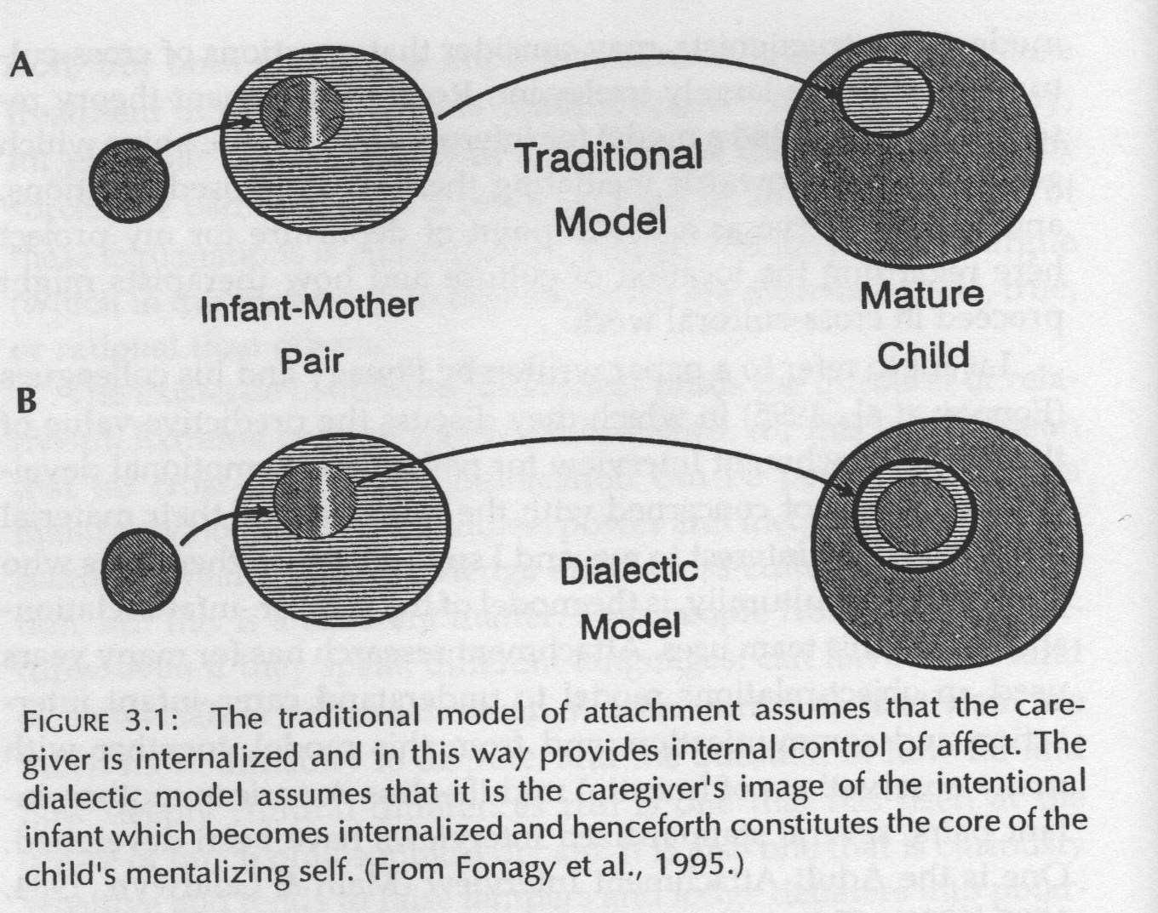
Infant/carer relationship

Slide 18
Inuit material
Jean L. Briggs (1998) Inuit Morality Play.
Baffin Island, Eastern Canadian Artic
Ethnography collected 1960s and 1970s

Slide 19
Present in sequence:
Mother Liila
Daughter (4) Rosy
Daughter (3) Chubby Maata
Mother’s sister (19) Luisa
Ethnographer Jean Briggs

Slide 20
Mother and children come into the room. They sit down. Rosy sits between Liila’s knees. Chubby Maata whines (sounds annoyed). No one moves. ‘Move her away’ Chubby Maata demands to her mother. Liila does not react. “Move her’ Chubby Maata demands again. No response. ‘Move Rosy away” Chubby Maata repeats. Liila is chewing gum and pulling it out of her mouth. Chubby Maata takes the

Slide 21
gum from her mother. ‘Do this’ Liila says smiling at Chubby Maata and in rapid succession claps her hands, slaps her knees, crosses her arms and holds her nose with one hand and her ear with the other. Chubby Maata imitates her mother, Rosy also imitates her mother. They all laugh together. Chubby Maata says to Liila: ‘Shall I sit here?’ pointing to a spot next to Liila. Liila is still making the gestures and

Slide 22
says: ’Do them sitting down’. Then she says ‘Yes’ .
Luisa enters the room and sits down behind the little group. ‘Pretend you are Jean’ she says to Chubby Maata. Chubby Maata says Jean’s name but mispronounces it. Rosy corrects her sister. Chubby Maata repeats the name correctly.

Slide 23
Liila says (with affection and in a high voice) to Chubby Maata: Cry like a little baby, because you are a baby. Chubby Maata imitates her mother’s voice and cries. Liila hugs her daughter and says “you darling little one’. Liila says to Chubby Maata: ‘father’, ‘mother’, ‘suck’ and ‘food’. Chubby Maata repeats the words one by one. They do it again. From behind Luisa pushes Chubby Maata’s bottom

Slide 24
with her shoe. This gives Rosy the idea, she now also pushes Chubby Maata with her foot. Liila says to Chubby Maata: It is because you are a baby she is attacking you’. Rosy and Chubby Maata wrestle with each other on the floor. Liila says: ‘cry like a baby and I will rescue you’. Chubby Maata does not respond immediately but then cries and Liila pushes Rosy away from her sister. Liila holds her hand out to

Slide 25
Rosy, who trustfully comes towards her. Lilla’s arm shoots out to imprison Rosy. She holds Rosy down and says to Chubby Maata. ‘Hurt her, make her angry, hold your hand on her head so that she cannot get up’ Chubby Maata says: ‘shall I pull her hair? Rosy cries. Liila says: ‘No just hold your hand on her head so that she cannot get up’.

Slide 26
Rosy resists this and gets the upper hand and after a little while Liila says to Chubby Maata, ‘Cry like a baby and I will rescue you’.

Slide 27
Group discussion
What resonates and what does not resonate for you? What are the participants doing in this sequence?

Slide 28
Inuktitut language
Ungaalirit – say ungaa
to cry like a baby,
to feel dependent attachment or longing
to wish to be with another person
to arouse the wish to be with another person

Slide 29
Inuit material and child development
Goals for socialisation are different in different cultures
When children learn a language they also learn a language of learning cultural values
These are largely unconscious or doxic
Imperatives from carers ‘say like that’, say ungaa create emotional dilemmas which are solved in cultural ways
Culture a process which presents a mosaic of dilemmas and solutions to these dilemmas
Emotionally charged situations and bodily experiences are good for learning

